Slide 1

University Database System
Ubaid Bin Waris | 2212416
Mushaid Hussain | 2212408
Muhammad Salman | 2212400
Jehanzeb Khalid | 2212391

Slide 2
Table of contents
01
04
02
05
03
06
Introduction
Data Manipulating
Database Schema
ER Diagram
Connectivity to Frontend
Conclusion

Slide 3
Database Schema
1. Departments Table
Attributes: department-id (PK), department-name, head-faculty-id (FK).
2. Students Table
Attributes: student-id (PK), first-name, last-name, date-of-birth, email (Unique), phone-number, enrollment-date, department-id (FK).
3. Faculty Table
Attributes: faculty-id (PK), first-name, last-name, email (Unique), phone-number, hire-date, department-id (FK)Constraints: UNIQUE(department-id, faculty-id).
4. Courses Table
Attributes: course-id (PK), course-name, credits, department-id (FK)
5. Enrollments Table
Attributes: enrollment-id (PK), student-id (FK), course-id (FK), enrollment-date, grade
Constraints: UNIQUE(student-id, course-id)

Slide 4
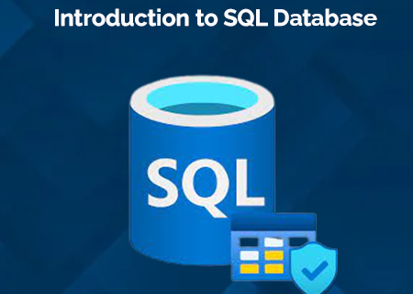
Introduction
The University Management System integrates a relational database with a frontend built in Next.js.
This system aims to handle various university operations, including managing students, faculty, courses ,Departments, enrollments, and schedules. The objective is to streamline administrative tasks and improve
Data accessibility for students, faculty, and administrators

Slide 5
Database Schema
6. Classroom Table
Attributes: room_id (PK), room-number (Unique), building, capacity
7. Schedule Table
Attributes: schedule-id (PK), course-id (FK), room-id (FK), faculty-id (FK), day (ENUM), time-slot
Constraints: UNIQUE(course-id, room-id, day, time-slot)
8. Fee Table
Attributes: fee-id (PK), student-id (FK), amount (DECIMAL), due-date, status (ENUM)
9. Library Table
Attributes: book-id (PK), title, author, status (ENUM), isbn (Unique), loaned-to- student-id (FK)

Slide 6
Schema Relationships and Constraints
Primary Keys Each table has a primary key (department_id, student_id, faculty_id, course_id, etc.) to uniquely identify records.
Foreign Keys Foreign key constraints ensure that relationships between tables (like department_id in Faculty and Students) maintain data integrity.
Unique Constraints Unique constraints, such as on email in Students and Faculty, ensure that certain attributes remain distinct across records.
Enumerated Data Types: For attributes with limited values (e.g., status in Library and Fees tables), ENUM data types improve data accuracy and constraints.

Slide 7
Database Connectivity with Frontend (Next.js)
1- Setting Up API Routes in Next.js
Create API routes in the pages/api directory to handle HTTP requests and interact with the database.
2- Database Connection
Use a connection utility to connect API routes to your database (SQL or NoSQL).
3- Fetching Data in Next.js Pages
SSR (Server-Side Rendering): Use getServerSideProps to fetch data on the server for pre-rendered pages.
CSR (Client-Side Rendering): Use useEffect and fetch to load data dynamically on the client.
4- Relational vs. NoSQL Database Integration
Relational (SQL): Use libraries like Sequelize for MySQL or PostgreSQL.
NoSQL (MongoDB): Use MongoDB’s native driver for connection and queries.
5- Data Flow and User Interaction
The front-end requests data from API routes, which query the database and return results for user interactions.

Slide 8
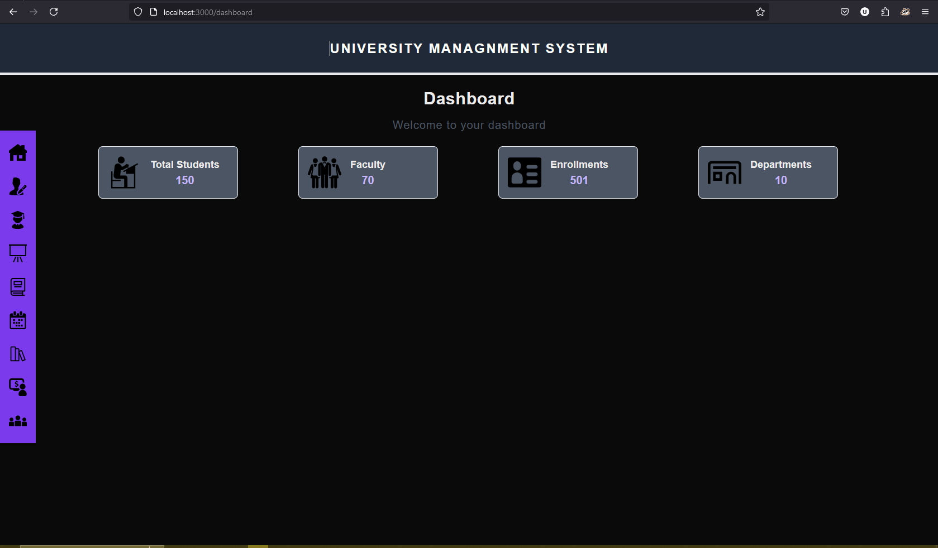
Data Manipulating
DashBoard

Slide 9
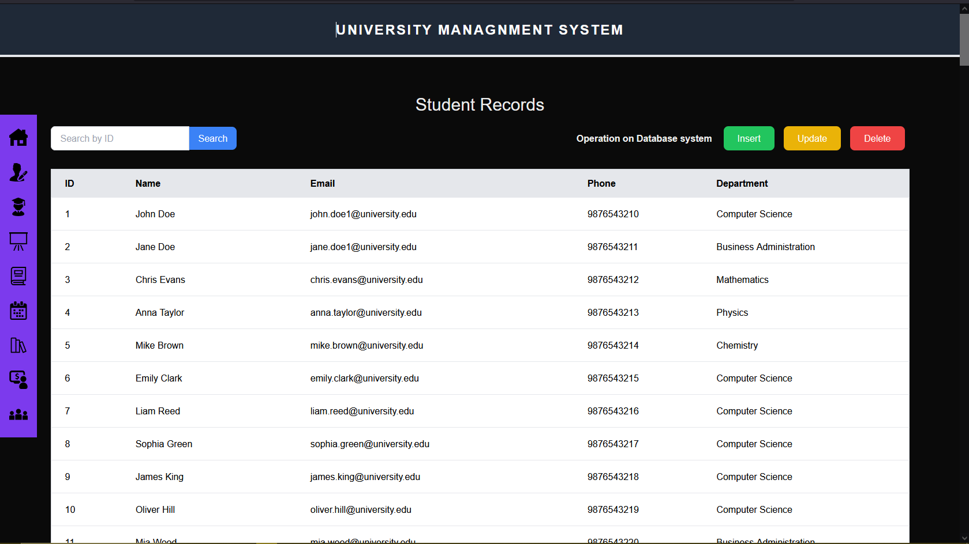
Student Record

Slide 10
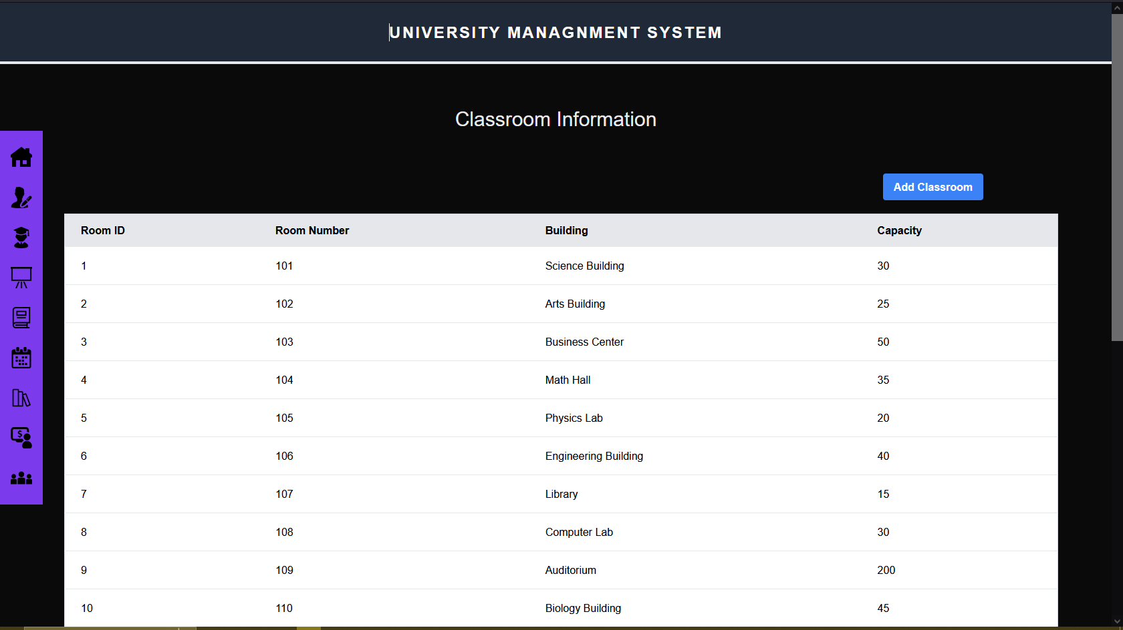
Classroom Information

Slide 11
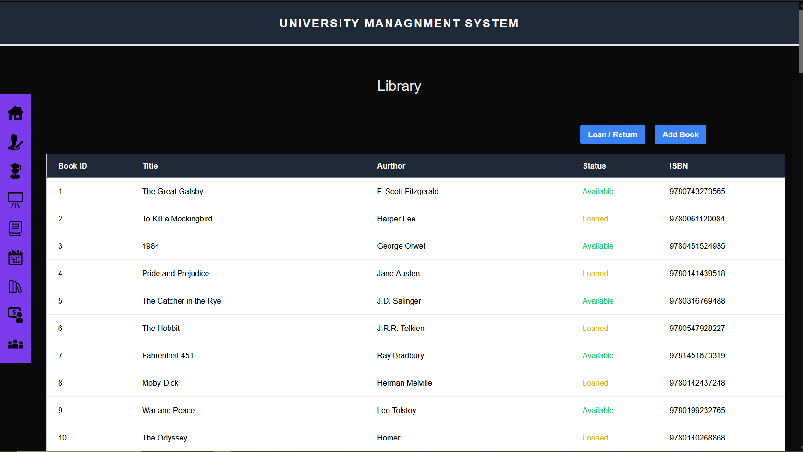
Library

Slide 12
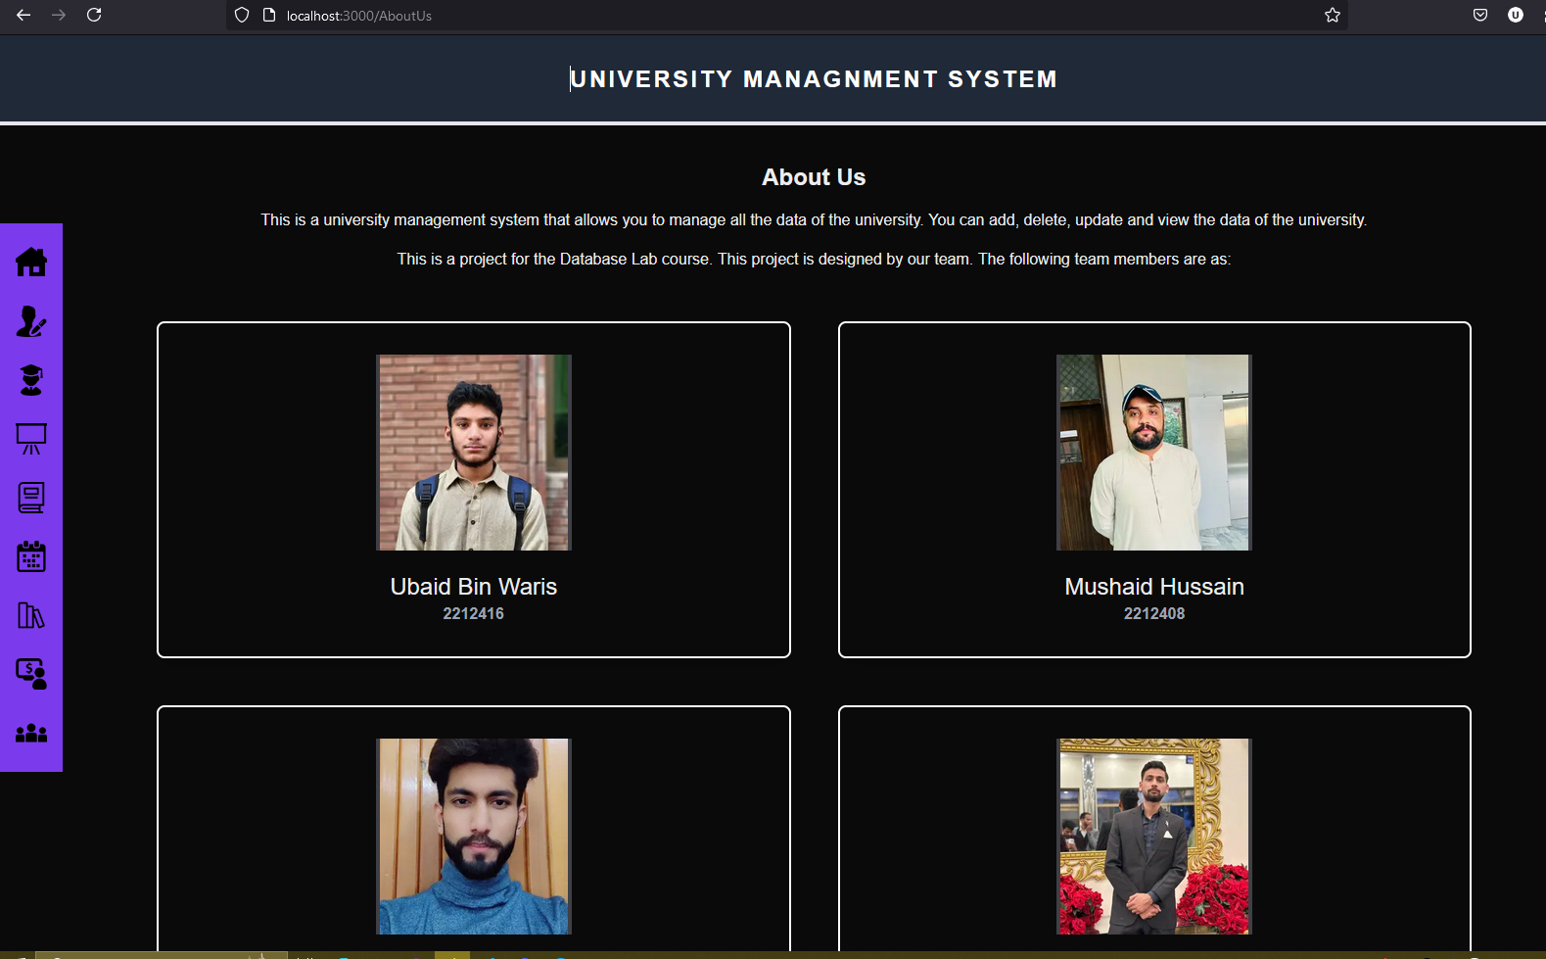
About Us

Slide 13
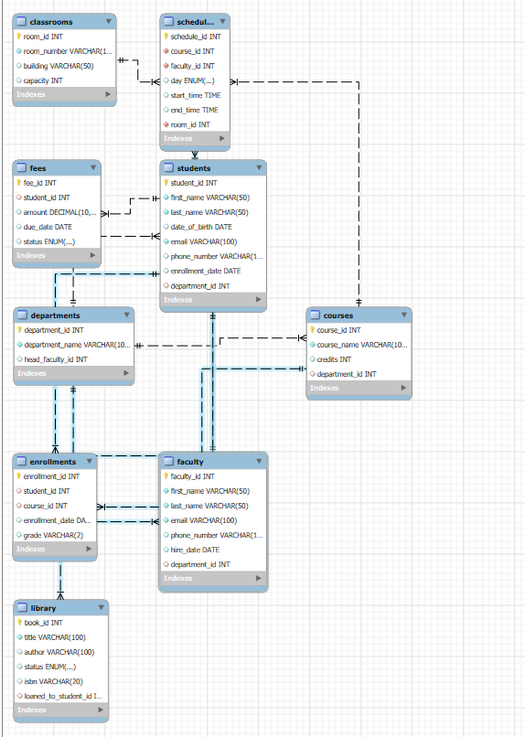
ER Diagram
ER DIAGRAM

Slide 14
Conclusion
The University Management System combines a powerful database and a user-friendly Next.js interface to simplify university operations. The database securely stores and organizes information like departments, students, faculty, courses, schedules, fees, and library records, ensuring accuracy and efficiency. The Next.js front-end provides easy-to-use dashboards for students, faculty, and administrators, working smoothly on all devices. Key features include course registration, timetable management, fee tracking, and library management, with real-time updates to support better decisions. This system saves time, reduces manual work, and can grow to meet future needs, making it an all-in-one solution for university management.

Slide 15
Thanks!
Do you have any questions?

